Slide 1
THE INDUSTRIAL REVOLUTION
Beginnings in Britain and Europe

Slide 2
Introduction
The Industrial Revolution was the second transformative “event” (even though it lasted about 100 years in conventional usage or has never ended in more radical usage … technologies keep on coming to transform both industrial processes and make new products). The explosion of long-distance trade, colonialism, and worldwide investment predated it.
Its geography is a continuation of the pattern in the three map-vignettes showing the shift in Europe’s economic center of gravity between 1450 and 1700. Capital accumulation and its redirection into new manufacturing industries was key to this transformation. This is why NW Europe was where the Industrial Revolution started. England was the epicenter (Figure 1).
But the Revolution did spread elsewhere over time as we shall see (Figure 2).
Themes for the day: 1. Why call it a “Revolution”? 2. Where did it take place? 3. It lasted through three waves connected to the Kondratieff Long-Wave Cycle. 4. The six factors in the location of industries of various sorts.
Next time: Lessons from history: the principles of industrial location.

Slide 3
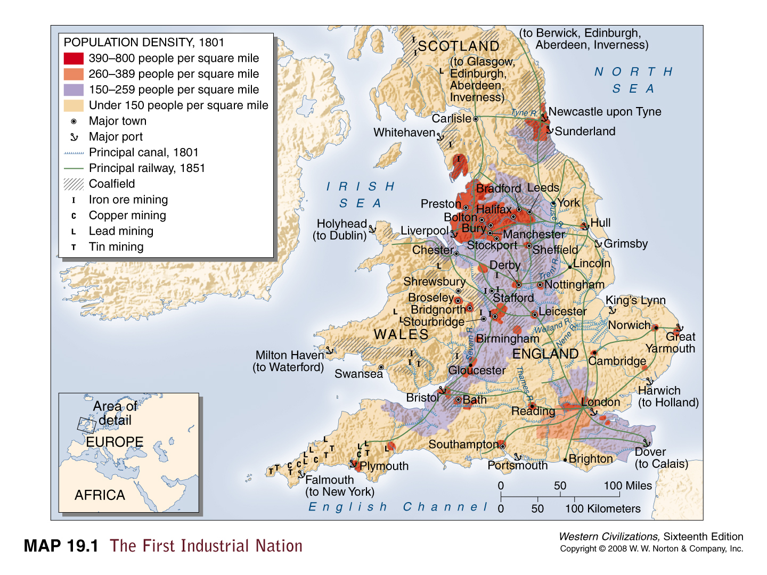
Figure 1: England as the locus in 1801

Slide 4
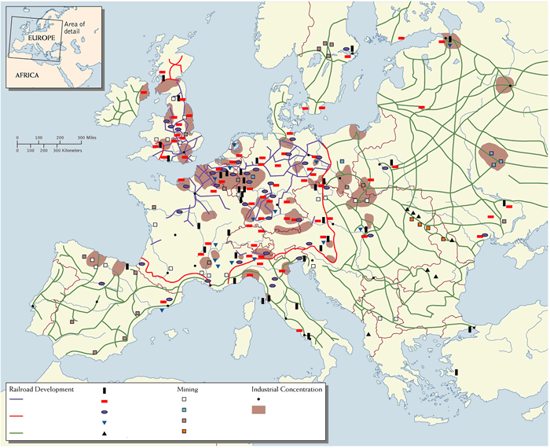
Figure 2: European Industrial Concentrations by 1900

Slide 5
WHY “REVOLUTION”?
1. Energy-intensive production (water and carbon) – water, steam, electricity
2. Mass production ( mass not batch production) – later assembly-line production and specialized repetitive labor tasks
3. New products: steam engines, railroads, steel, chemicals, drugs (capital goods initially more important than consumer goods)
4. Organizational changes: (a) at industrial level: specialized management, unskilled/semi-skilled labor, factories not workshops; (b) at legal/political level: firms as limited liability partnerships, joint-stock companies, national currencies and banking, stock markets.

Slide 6
Historical-Geographical Pattern
First “British” Wave: 1760-1850 – water/canal age (cotton textiles, iron) privileges upland locations with waterpower: Phase I: (1760-1790) proto-industrialization; Phase II: (1790-1820) embryo industrial regions; Phase III (1820-1850): railway links and coalfield sites as centerpieces of industrial regions.

Slide 7
Second Wave: 1840-1890 – steam age (textiles, steel, chemicals, armaments, steel ships, locomotives, and railroads) – corporate “personhood” to separate ownership/control from liability; trusts and large firms e.g. US Steel.
Located in Britain and “Inner Europe” – Belgium, northern France, western Germany.

Slide 8
Third Wave: 1890-1920 – electricity, motor age (many of the same products and processes) except for use of electricity and internal combustion engine – these allow for more “footloose” location away from waterpower or coalfield sites.
Located widely across Europe -- spread to “Outer Europe” – Sweden, Russia, northern Italy.

Slide 9
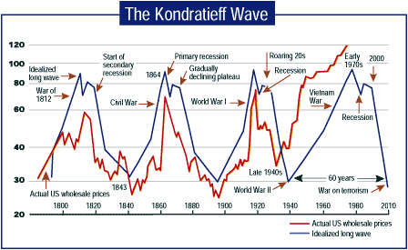
Links to Kondratieff Long-Wave Cycle

Slide 10
Factors in Geographical Location of New Industries
Capital from merchant capitalism, colonialism, and suppressing wages
Application of science to production (returns to scale)
Fuel sources: water, coal (for steam power), water, oil, and coal (for generating electricity) – leads to high importance of transport costs particularly in Waves I and II
Labor source

Slide 11
Avoidance of areas with craft/artisanal production (Luddites)
High level of industrial specialization at the local level (towns that specialize in spinning thread and weaving cloth; gun and jewelry districts)

Slide 12
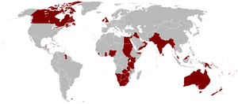
Figure 3: The British Empire as a source of raw materials and destination for investment and sales of manufactured goods

Slide 13
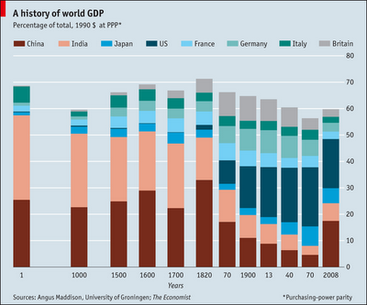
Figure 4: The more efficient British and other European producers forced smaller-scale producers in India, China, and elsewhere out of business

Slide 14
PRINCIPLES OF INDUSTRIAL LOCATION
Transport costs and industrial location (Alfred Weber’s “industrial triangle”) (Figures 1, 2, 3, 4)
Economies of scale (and returns to scale –technology) (Figure 5)
Agglomeration economies (specifically localization economies; there are also urbanization economies) (Figure 6)

Slide 15
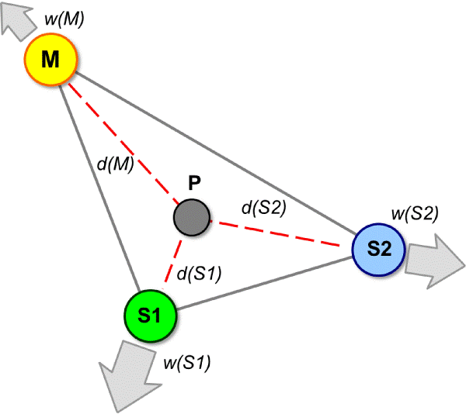
Figure 1: Alfred Weber modeled industrial location by using a pulley and weights logic. If S1 is the weight in production costs of a raw material and S2 of another one and transport costs are different for each and in supplying the final market of M then the final location will be a function of the “pulling power” of the different costs. As in the early Industrial Revolution it is based on the idea that transport costs are central to the locational calculus of the firm or business. This is the First Principle of Industrial Location.

Slide 16
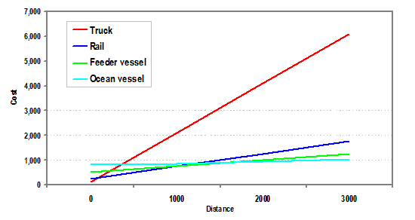
Figure 2: But historically transport costs have become much less central to the location of factories. Why? 1. Less dependent on moving raw materials as light industries have replaced heavy ones 2. Improved efficiency of modes of transport, particularly over long distances by sea and rail 3. Shift away from burning coal as source of energy which was a major constraint on location when coal must be burned and thus loses weight. Why transport coal long distances to then burn it?

Slide 17
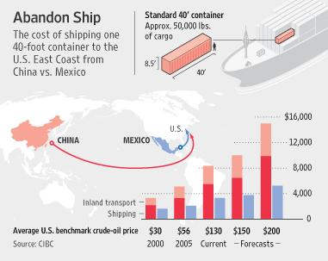
Figure 3: Over the past fifty years with container ships and relatively low oil prices it has become possible to ship things over long distances at low cost. But if oil prices increase (because of shortage or carbon taxes) then the costs of movement go up immensely. In this diagram, shipping from China isn’t that much more expensive than shipping from Mexico but with forecast increases the scenario changes significantly.

Slide 18
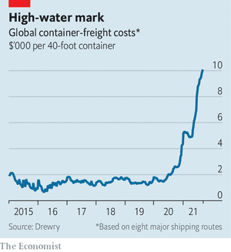
Figure 4: Transport Costs Making a Come back?

Slide 19
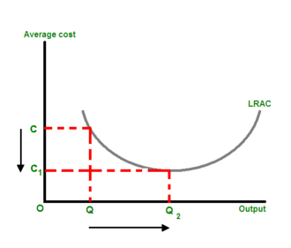
Figure 5: The Second Principle is that of Economies of Scale in Production. This states that it pays in terms of efficient use of inputs (raw materials, labor, etc.) to produce at a scale that then maximizes output. On the LRAC (Long run average cost curve) this is at point Q2 so it would pay if current production is at Q to move to a capacity that would produce at Q2. Average costs per unit produced would then decline from C to C1. Diseconomies set in after Q2.

Slide 20
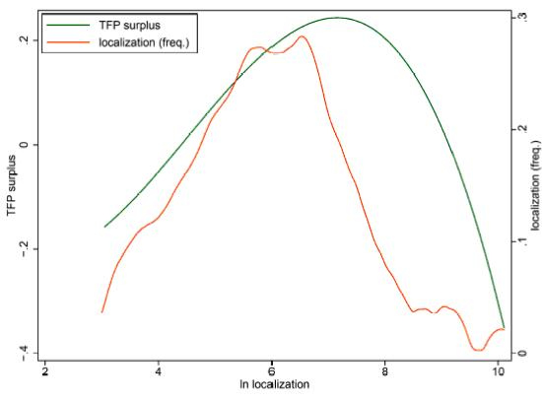
Figure 6: The Third Principle is that of Agglomeration Economies or economic returns to clustering of similar industries (specialization) through being close to competitors (localization economies) and sharing common services (urbanization economies). Historically, many industries develop as clusters (think of Pittsburgh and steel, Detroit and motor vehicles, Silicon valley and computer soft and hardware, Hollywood and movies). They can recruit from specialized labor pools, specialized venture capitalists, training venues, etc. This graph shows a “surplus” accruing to a business (orange line) even as it fails to match the idealized return (green line) associated with locating adjacent to similar businesses.

Slide 21
Conclusion
Transport costs have really diminished as a part of the locational calculus of businesses. But they still matter, above all in relation to heavy industries (like steel and vehicle assembly). Location close to rail lines and seaports is one of the more significant continuing impacts of transport costs given the cost of truck movement. If oil prices increase or are subjected to carbon taxes then the current reliance on long-distance ocean shipments may also diminish (independent of such factors as blocking canals!)
Factory or plant economies of scale are still important. In fact, the concept of economies of scale extends also into considering the returns to production from serving a larger market (up to a certain point when diminishing returns set in). But as a principle of the location of production it suggests how important having access to adequate resources and skilled labor and machines still is in driving location decisions.
Finally, agglomeration economies have also retained their importance. So far, at least before the pandemic, the idea of remote working substituting for face-to-face engagement had not led anywhere much. Time will tell. But this principle seems very well justified if the past two hundred years is any guide!!

